Slide 1
Introduction
Artificial Intelligence

Slide 2
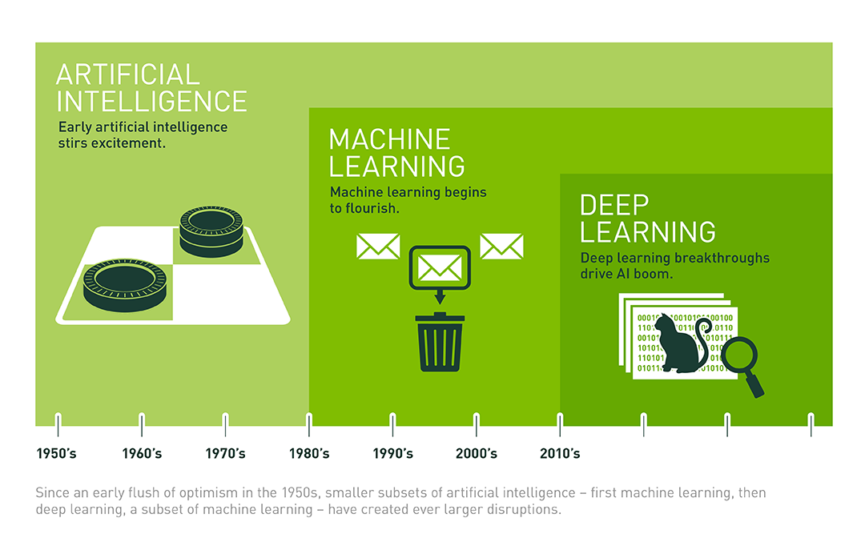
History!

Slide 3
Phase-1
Welcome!
Machine Learning

Slide 4
Honor Code
( Ethics )
Compliant to Engineering Ethics
Ensure privacy and security ( both physical and informational ) of end-users
Collaborate ( Nationally and Internationally )

Slide 5
What is machine learning ?
Google Search
Email spam
Self-driving cars

Slide 6
What is Machine Learning ?
Using data to build a software which will be called “Model” and use that model to predict future outcomes.

Slide 7
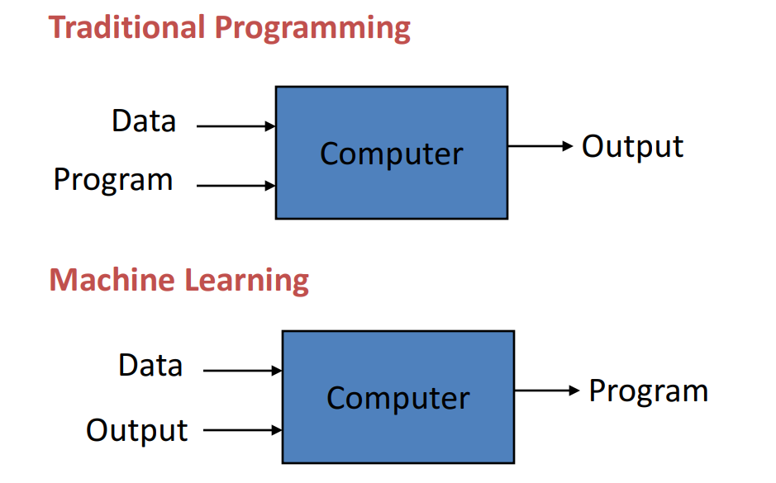
What is Machine Learning ?

Slide 8
Types:
Machine Learning
Supervised Learning
Unsupervised Learning

Slide 9
Introduction
Supervised Learning

Slide 10
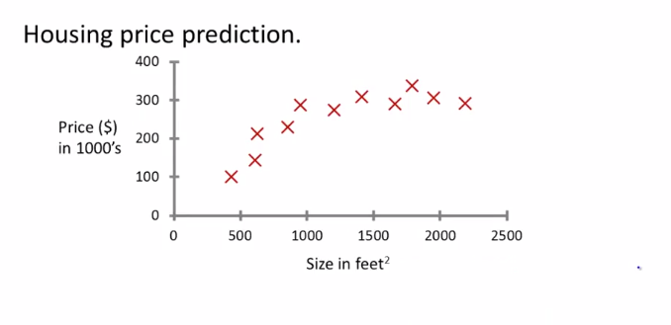
Supervised learning : Answers are given to the algorithm

Slide 11
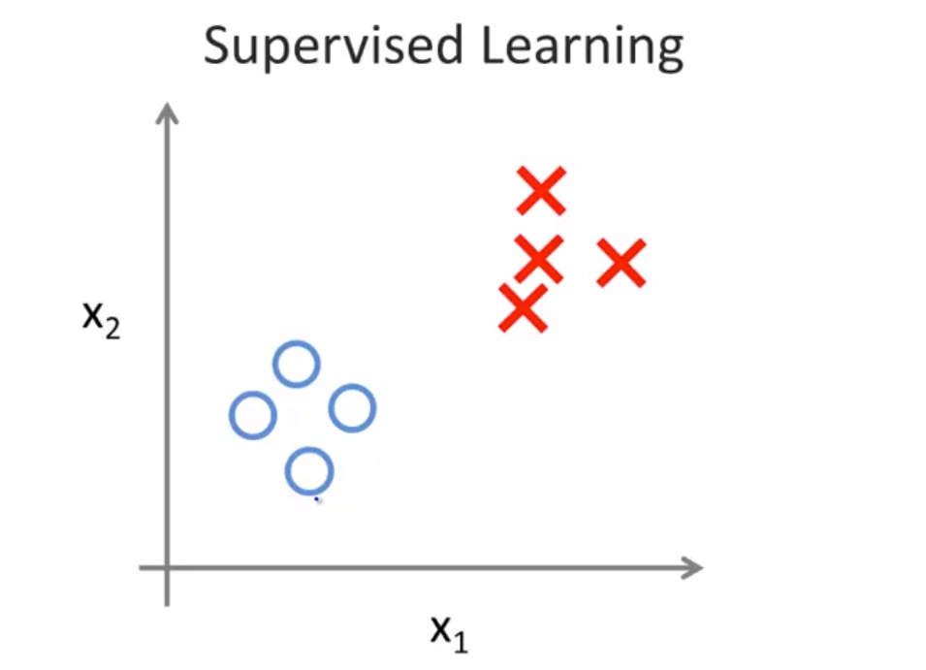
Positive / Negative Tweets

Slide 12
Supervised Learning
Supervised learning is a type of ML where the model is provided with labeled training data
Color | Space | Model | Price
Black | 32GB | IPhone | 160,000
White | 32GB | IPhone | 140,000
Gold | 32GB | IPhone | 170,000
Black | 16GB | Android | 80,000
Yellow | 16GB | Android | 75,000
Black | 32GB | Android | 100,000

Slide 13
Some Terminologies ( Feature, Label )
Color | Space | Model | Price
Black | 32GB | IPhone | 160,000
White | 32GB | IPhone | 140,000
Gold | 32GB | IPhone | 170,000
Black | 16GB | Android | 80,000
Yellow | 16GB | Android | 75,000
Black | 32GB | Android | 100,000

Slide 14
Unsupervised Learning

Slide 15
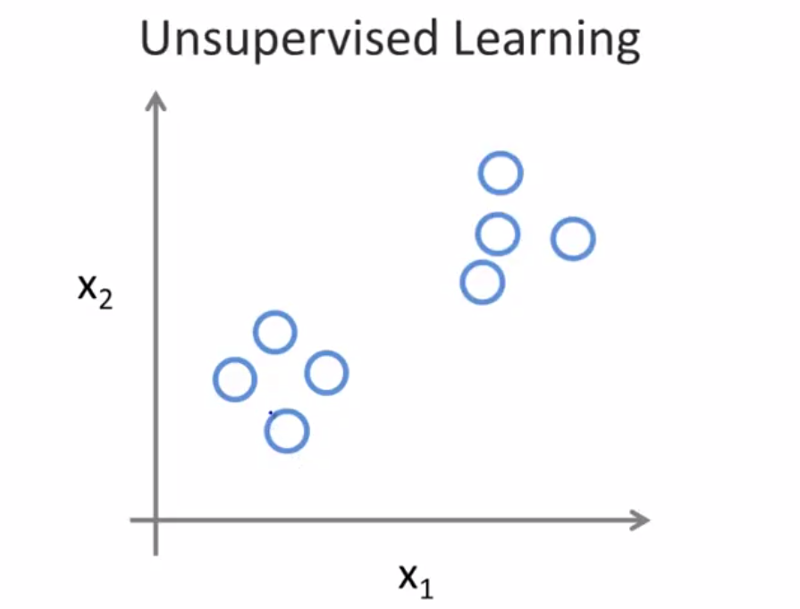
A Comparison

Slide 16
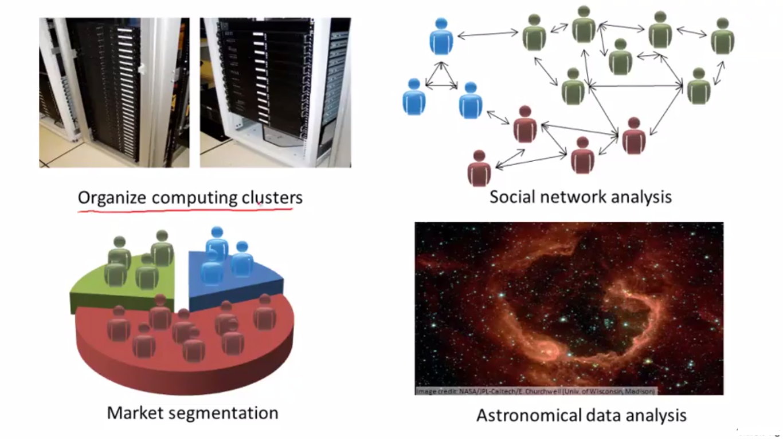
Some Examples

Slide 17
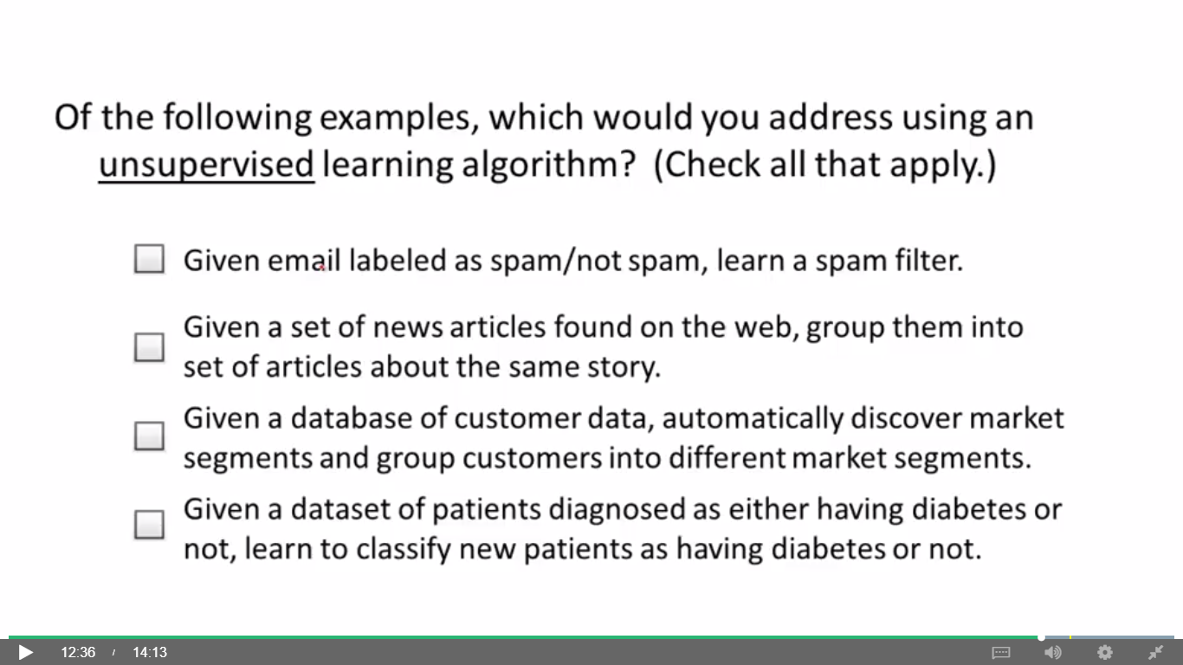
A Question !

Slide 18
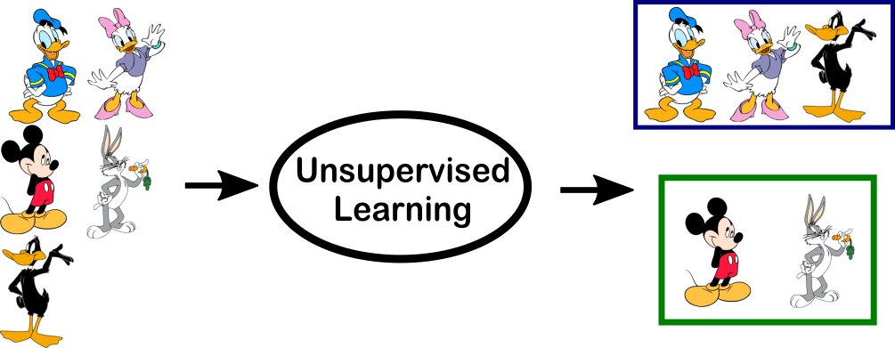
Unsupervised Learning
Data at hand is not labeled. We use machine-learning to understand relationship between data.

Slide 19
Supervised Learning : Problem Types
Type | Description | Example
Classification | Pick 1 of N Labels | Is it a cat or Dog ?
Regression | Predict Numerical Values | What is the price of iPhone ?

Slide 20
Representing a Model

Slide 21
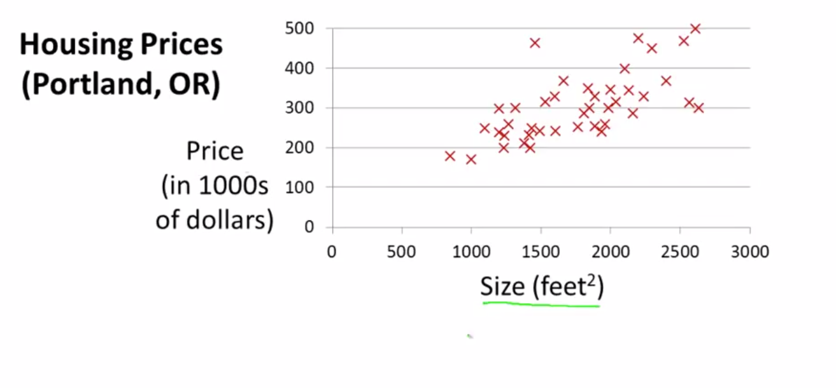
Model Representation

Slide 22
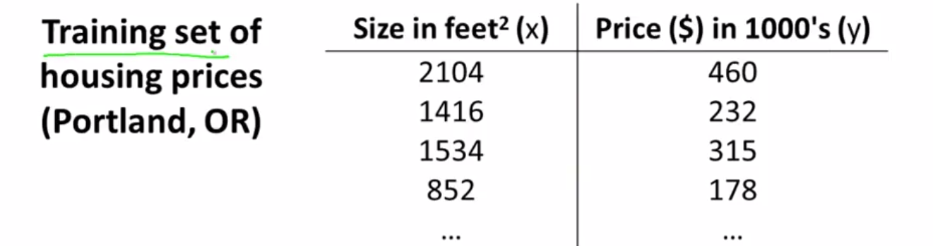
Model Representation
M = Training Set
X = Input Features
Y = Output Variable/Target Variable
M = ( X, Y )
(Xi, Yi) = Single Training Values
Example (X1, Y1) = ( 2104 , 460 )
(X1, Y2) = ( 1416, 232 )

Slide 23
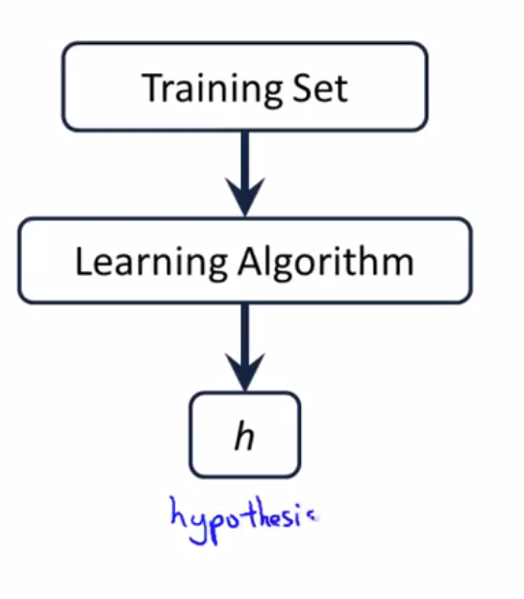
Model Representation

Slide 24
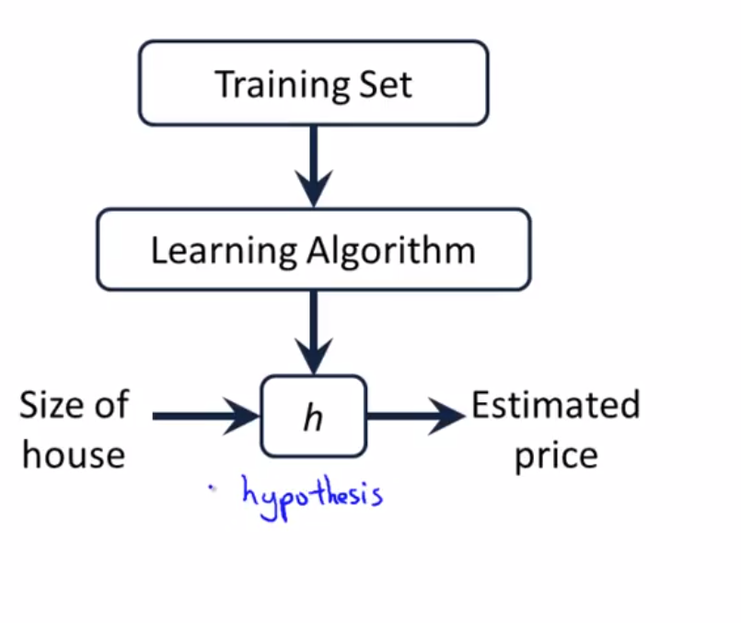
Model Representation

Slide 25
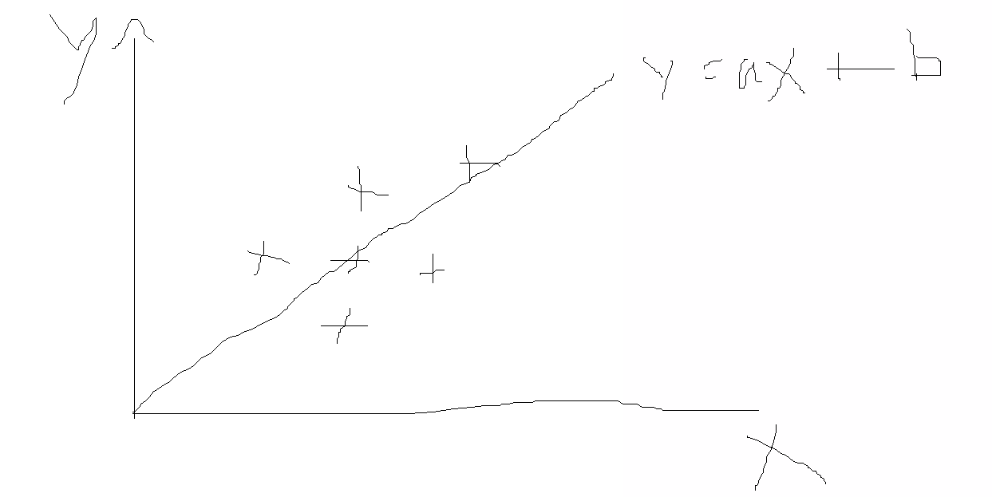
How do we represent this hypothesis ( Model )
Y = aX + b

Slide 26
Cost
Function

Slide 27
Cost Function!
Our Model :
Y = aX + b
How do we chose (a, b )

Slide 28
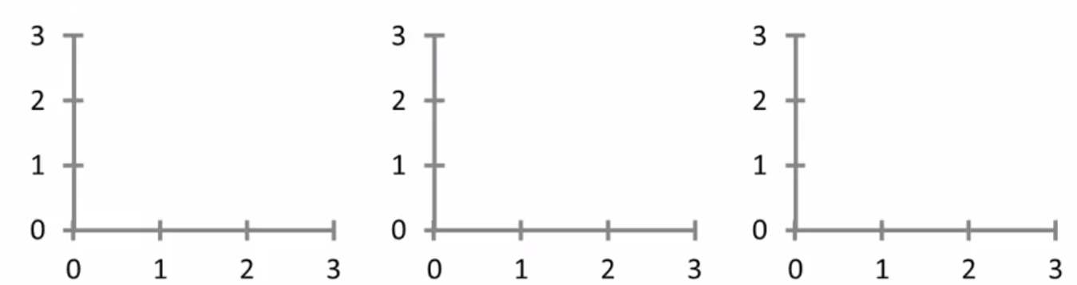
Cost Function
Y = aX + b
a = 0
b = 1.5
a = 0
b = 0.5
a = 0.5
b = 1

Slide 29
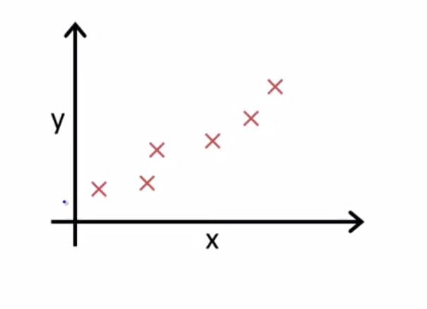
Cost Function
H(x) = Y = aX + b
Idea is to choose values for (a, b) so that H(x) is close to the Y for our training examples

Slide 30
Cost Function
Minimize (a, b) =
1/2m * Σ sqr(( H(a,b)(x) - Y))

Slide 31
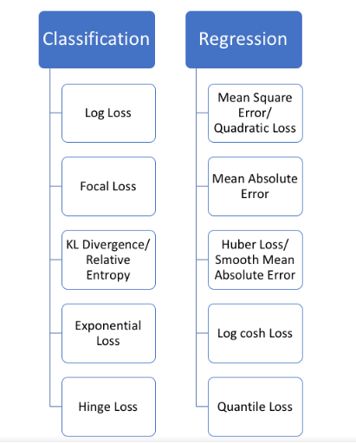
Cost Function : Some Examples.

Slide 32
Optimizer

Slide 33
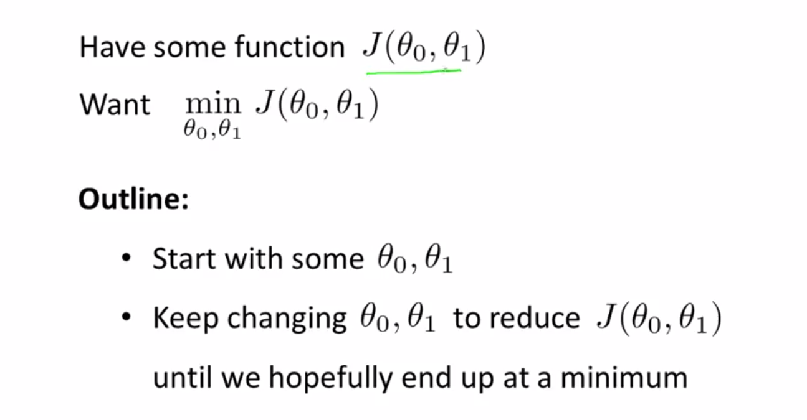
Cost Function : Some Examples.
I have replaced a, b with θ1, θ0 )

Slide 34
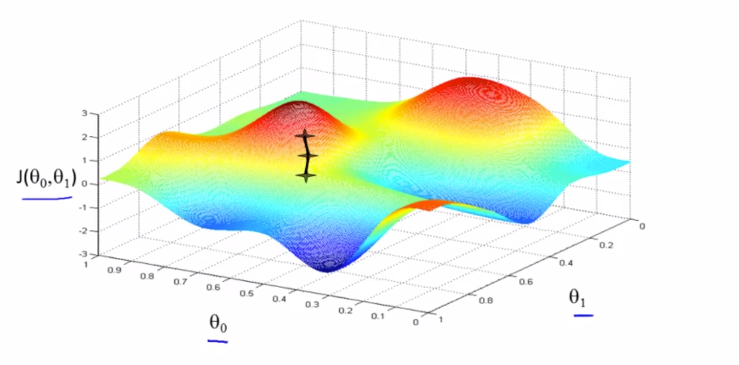
A popular Optimizer : Gradient Descent
Size of the step taken is called “Learning Rate”

Slide 35
Popular Optimization
SGD
Stochastic Gradient Descent
ADAM
Adaptive Moment Estimation

Slide 36
ML Mindset
“Machine Learning changes the way you think about a problem. The focus shifts from a mathematical science to a natural science, running experiments and using statistics, not logic, to analyse its results”
Peter Norvig - Google

Slide 37
ML : Scientific Method
Step | Example
1.Set Goal | I want to predict how heavy traffic will be on a given day.
2. Make Hypothesis | I think the weather forecast is an informative signal.
3. Collect the data. | Collect historical traffic data and weather on each day.
4. Test your hypothesis. | Train a model using this data.
5. Analyze your results. | Is this model better than existing systems?
6. Reach a conclusion | I should (not) use this model to make predictions, because of X, Y, and Z.
7. Refine hypothesis and repeat. | Time of year could be a helpful signal.

Slide 38
ML : Programmers Method
Step | Example
1.Set Goal | I want to predict how heavy traffic will be on a given day.
2. Collect Data | Collect historical traffic data and weather on each day.
3. Chose Model | Chose a model ( LinearRegression, Support Vector Machine )
4. Chose Features | Select Features from data
5. Chose a Cost Function | RMSE, LogRMSE,
6. Chose Optimizer | Chose an optimizer for your model ( SGD, ADAM)
6. Train the Model | Train model using above parameters
7. Refine Model and repeat. | Refine your model and parameters for most optimum outcome

Slide 39
Questions!
Predict data usage rate of a mobile phone user ?
Predicting house prices ?
Is it a iphone or Android phone from set of phone pictures ?
A man of Woman ? from pictures

Slide 40
Our Focus
Supervised Machine Learning
Regression
Classification

Slide 41
Before We Begin !
Python
Numpy
Pandas
scikit-learn
Machine Learning : Tools & Technologies

Slide 42
Before We Begin !
Install Python 3.5.4
Go to python downloads
Chose 3.5.4 installer
Click Install
Install Virtual Environment
Pip install virtualenv
Start Virtual Environment
virtualenv env
Scripts\activate
Install Jupyter Notebook
Something with Jupyter
Environment Preparation

Slide 43
Phases of Machine Learning
Define a Problem
Collect Data
Transform Data
Train A Model
Make Predictions

